Slide 1
Nvidia Mosaic and UniCAVE on the CEWIT Silo
Alex Cuba 111560392

Slide 2
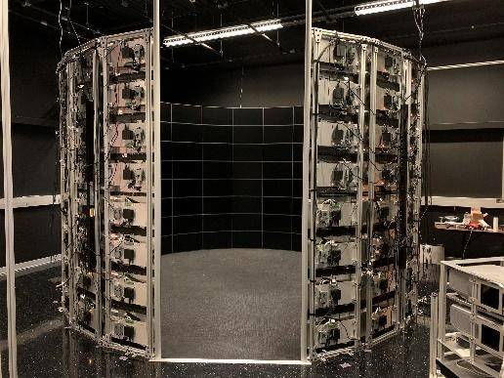
Introduction
Main Goal: Optimize the performance of immersive programs
Instead of rendering 32 small screens, instead render 8 larger screens
Goal was reached through the use of two separate applications
Nvidia Mosaic: Command line application which presents multiple physical screens as one logical monitor to the operating system
UniCAVE: A Unity plugin which allows users to develop a screen layout for their stationary VR display systems
Worked on two separate stationary VR systems
Six screen tiled setup in the New Computer Science (NCS) Lab
Silo in the Center of Excellence in Wireless and Information Technology (CEWIT) VR Lab
CEWIT Silo: Dozens of Screens separated into Nodes
Each node is 32 screens controlled by 8 GPUs (4 Screens per GPU)

Slide 3
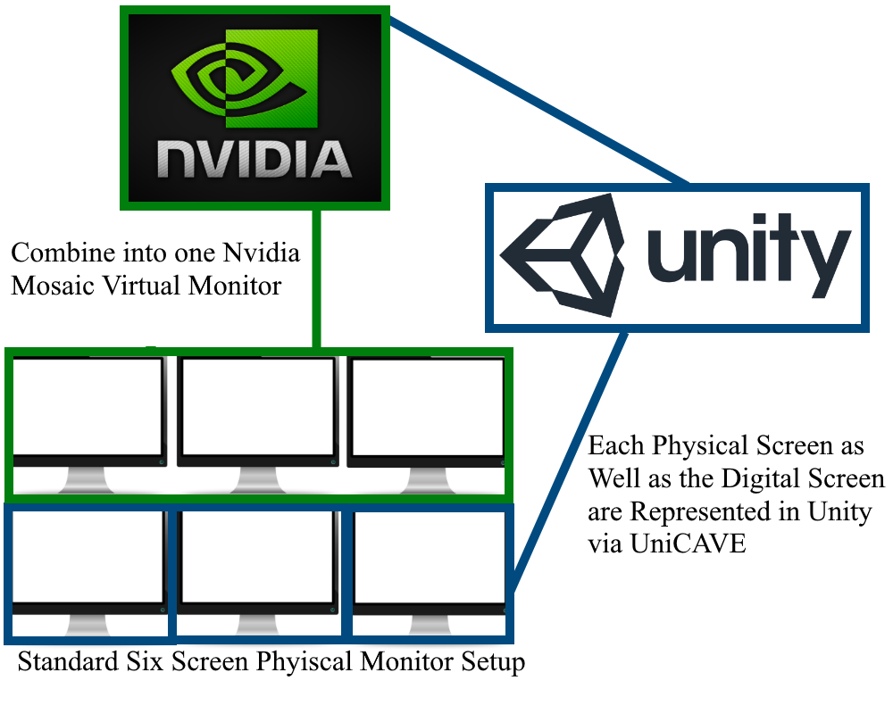
Methodology
Using a batch file, run a series of Nvidia Mosaic commands which create the desired digital topology
Also allows for bezel correction
In Unity with UniCAVE, design a scene which corresponds to the digital and physical topology
When running the UniCAVE Project in connection with the Nvidia Mosaic, it creates an seamless immersive scene with less performance overhead than a standard Unity Project

Slide 4
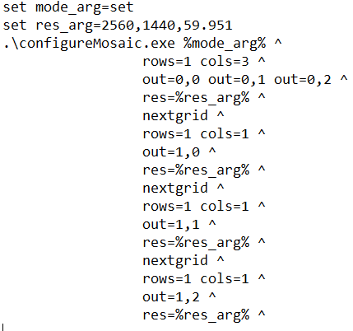
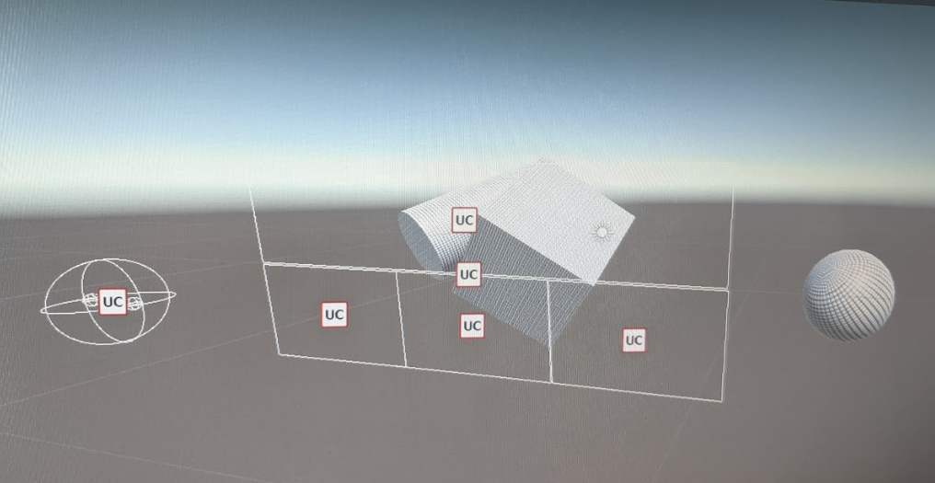
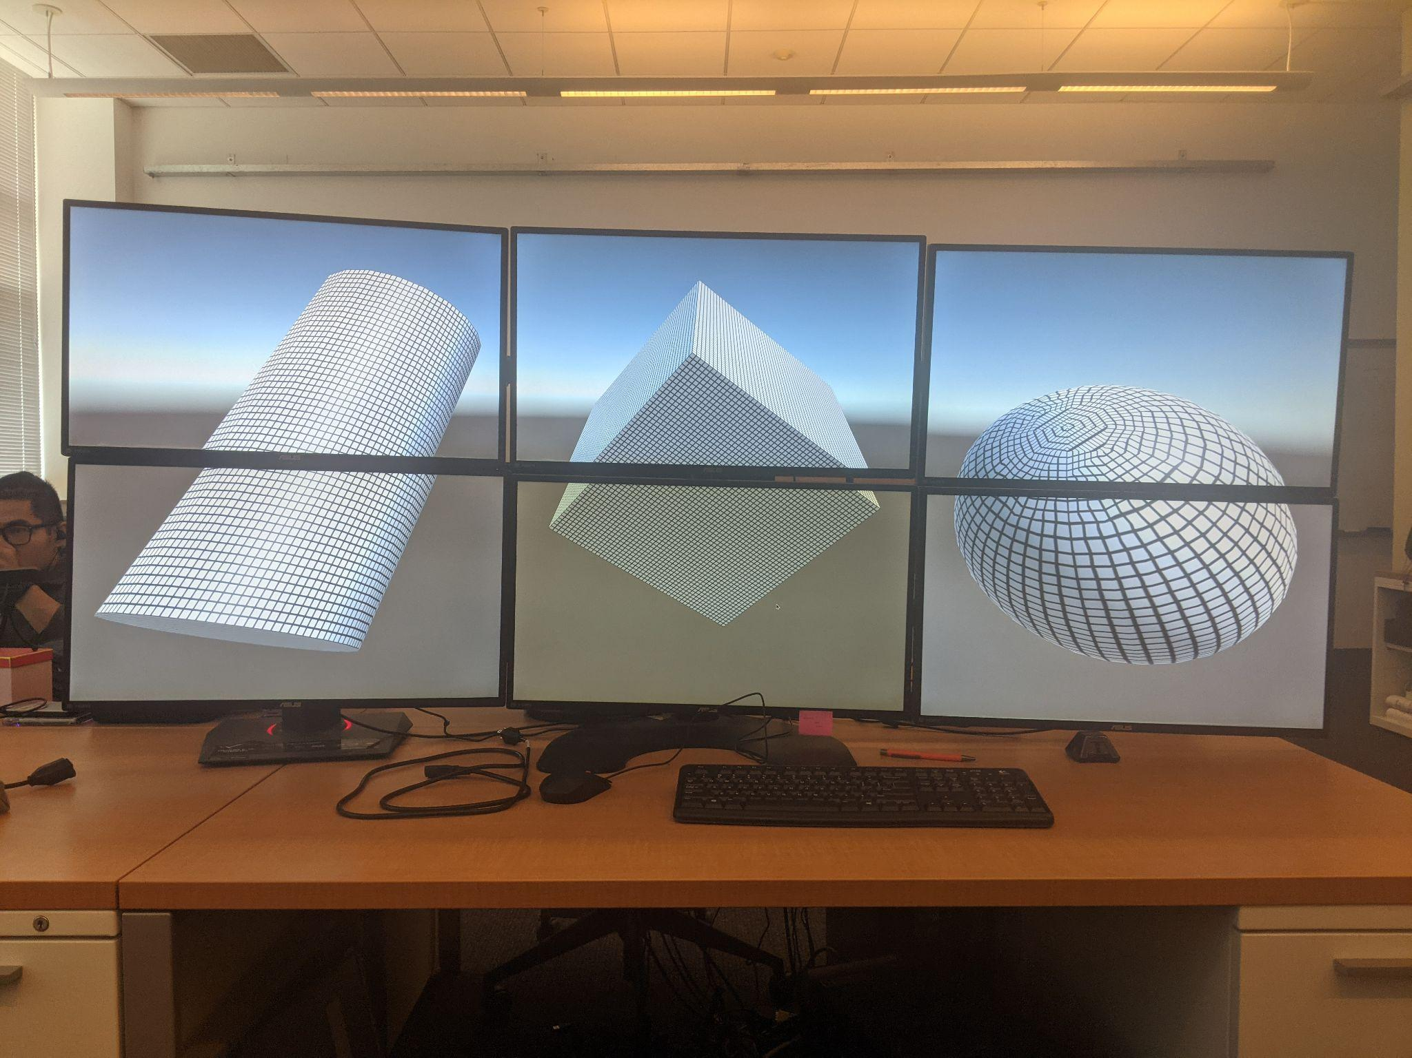
System Overview
Nvidia Mosaic Batch File
UniCAVE Unity Project
Final Project Running on NCS Six Screen System

Slide 5
Nvidia Mosaic
Allows for multiple physical screens to be combined into one unified environment
Despite being multiple screens in the real world, the OS only recognizes them as one large screen
Two main problems arose when initially attempting to construct operable batch files
Lack of knowledge on command line functionality
Lack of easily obtainable documentation related to the command line program
Eventual reverse engineering of preexisting batch files provided to me as well as the obtaining of some documentation resulted in an understanding of the technology
Was able to create three working batch files across the two main system (NCS and CEWIT)
6 Screen Tiled Setup for NCS (Each screen is its own monitor)
4 Screen Tiled Setup for NCS (Top Screens combined into one monitor, each bottom screen its own monitor)
8 Screen Tiled Setup for Silo (4 Screens per monitor, 1 Screen per GPU)

Slide 7
Nvidia Mosaic on Silo
When testing the Nvidia Mosaic application on the Silo, there were three main problems that arose and are currently unresolved
Bezel Correction Does not Work across full 32 screen node
Works on the six screen NCS setup and 16 screen half node but not on 32 screens regardless of the values put in
Cannot make a full 32 screen Mosaic
Can combine a 16 screen half node into one monitor, but cannot do so for 32
Crashes entire OS and requires a refresh
Possibly related in some way to the bezel correction issue
Nvidia Mosaic topology does not allow multiple GPUs across multiple monitors
Either all GPUs must be in one monitor, or each GPU must have its own monitor
Other configurations throw a “NO_VALID_GPU_TOPOLOGY” flag
Can achieve full screen effect with default windows display settings, but can cause performance issues

Slide 8
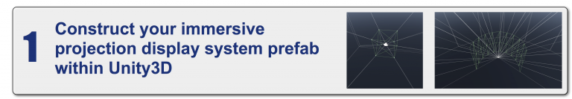
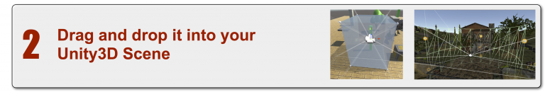
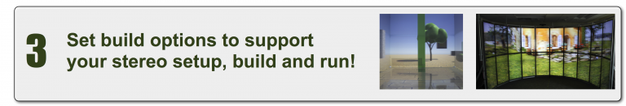
UniCAVE
Unity plugin developed by the students and researchers at UW-Madison
Allows Unity to provide support to non-head mounted VR display systems such as CAVEs
This is done through the use of various scripts provided by the plugin that allows for the construction of system prefabs
Lets the user define the size and location of the screens, as well as the head of the user
Overall easier for me to work with than the Nvidia Mosaic application
More initial familiarity with the Unity program
More detailed and readily accessible documentation
Initial problems were much smaller in scale and were more commonly the result of user error than lack of knowledge or familiarity
Built project kept crashing on startup -> incorrectly defined network management script

Slide 9
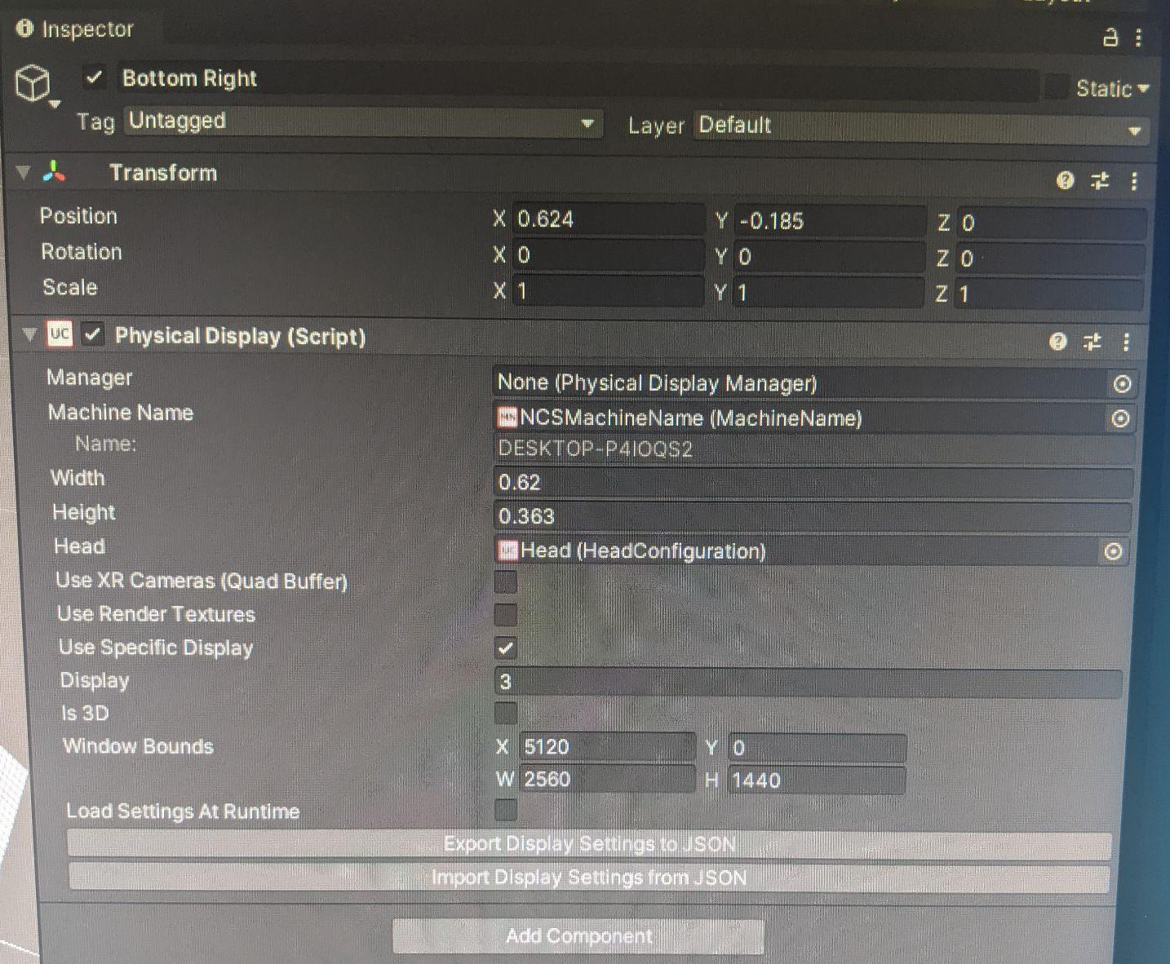
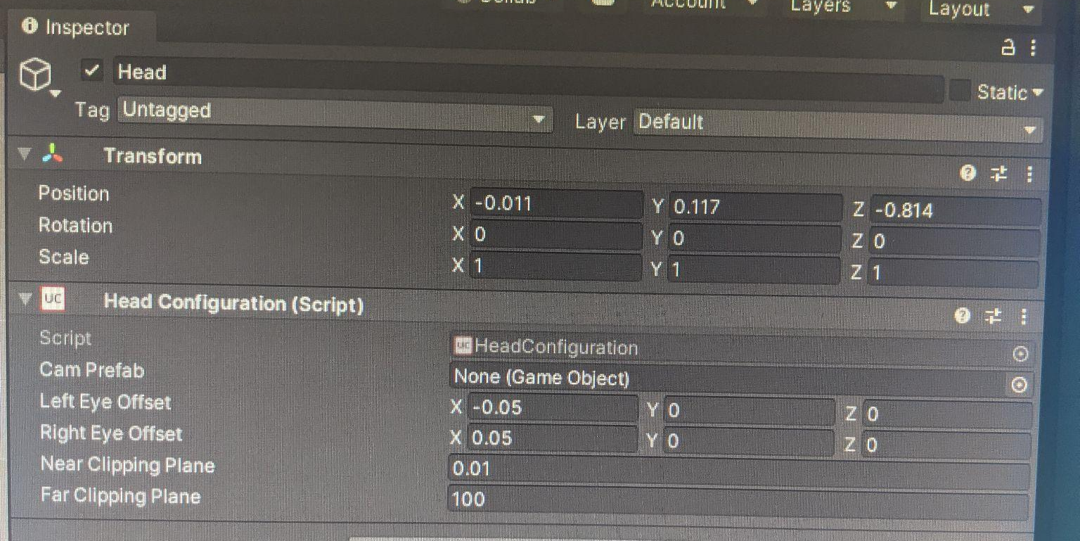

Slide 10
UniCave on Silo
More severe problems were encountered during the transition from the NCS setup to the CEWIT Silo
Application did not correctly enter fullscreen
Did so naturally on the NCS setup, but would only full screen across one monitor on the Silo (caused UniCAVE project to only fill up one eighth of the display)
Solved by running project in a large borderless window that covered the size of the entire display.
Gives impression of full screen without getting caught up on one of the monitors
Lack of correctly working stereoscopic 3D
Both the Silo node and the NCS setup were having difficulties booting into stereo
Caused issues when trying to project images in 3D (next slide)
Saeed and I determined it was issues with the hardware being used, and not any issues with the software
Will be left as future work, but should be easy to resolve

Slide 11
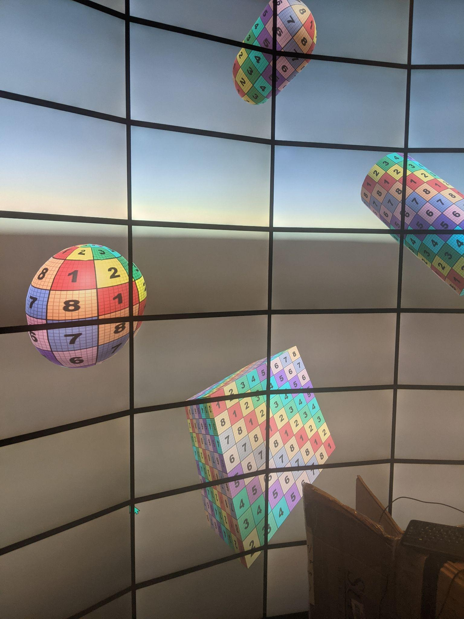
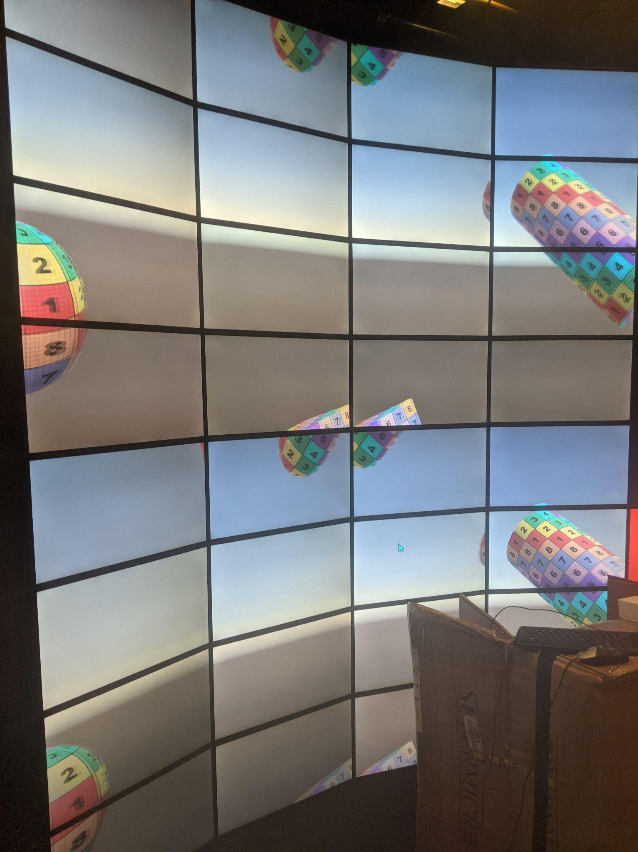

Slide 12
Results and Future Work
Three Nvidia Mosaic batch files and two UniCAVE projects across two systems
Detailed documentation on how to use/modify both of the applications
However, there is still a lot of potential future work that can be done
Introducing stereoscopic 3D
Should be relatively simple, only involves changing some settings within the project itself
More immersiveness in the UniCAVE scene
Introduction of more complex models (OBJs or prefabs)
Should be an easy way to add more detail to the scene
Animated objects (trees blowing in wind, people walking on a path, etc).
Allow the user to have control over the environment
Move the camera around the scene (either through translation, rotation, or both)
Extend the project across all the Silo nodes
Only one node was available during my testing, but having the full Silo running will lead to maximum immersion

Slide 13
Conclusion
To conclude, my main contribution with this project is a highly modifiable Nvidia Mosaic and UniCAVE system that is intended to increase immersiveness and performance on both the NCS six screen tiled setup and the CEWIT Silo setup
In general I was very happy to be given the opportunity to work on this project
Allowed me to learn command line interfaces
Also helped increase my knowledge and familiarity with programs like Unity
If anyone is interested in looking at the materials associated with this project, you can use the following link
https://drive.google.com/drive/folders/160pEylw9NRN_baEhkKV5_9eYgONZUz1X?usp=sharing
Any questions?

